Slide 1

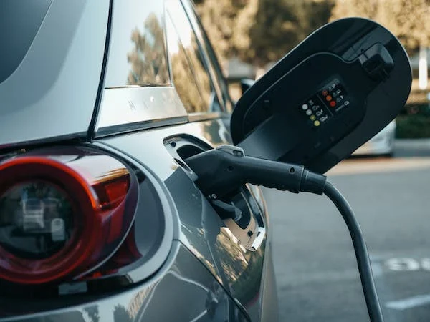
Electrical Cars Charging-stations in Palo Alto
Prepared by:
Birundha Varatharajan, Doaa Barqawi, Opeyemi Sodipe, Hui Wang

Slide 2
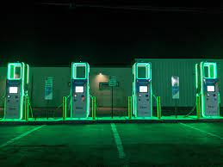
Data Sources
1-Kaggle
2-City of Palo Alto
EV Charging Station Usage of Palo Alto City
https://data.cityofpaloalto.org/home
3- California Energy consumption
https://www.energy.ca.gov/data-reports/energy-almanac/zero-emission-vehicle-and-infrastructure-statistics/light-duty-vehicle

Slide 3
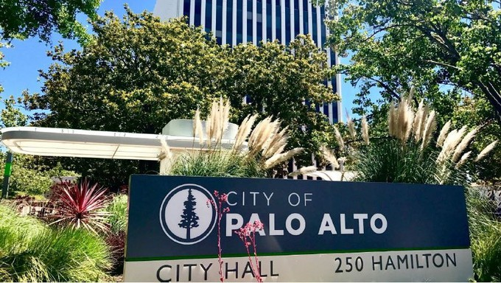
Palo Alto
Electric vehicles produce 60% fewer CO2 emissions
Electric vehicles (EVs) will be an important part of the American transportation future, given their potential to dramatically cut global warming emissions.
Palo Alto Decreased the Co2 Emissions with 54% in 2021 below 1990
Lifetime Ford EV CO2 savings vs .gas car (metric tons) / Source: Ford
https://sustainability-palo-alto.hub.arcgis.com/pages/goals-progress
In Palo Alto, 1 in 5 households drive an Electric Vehicle (EV) – the highest adoption rate in the country.

Slide 4





Project Overview
SQL
Python, SQL alchemy
Create Databases
Connect and clean Database
Flask API
Visualization
Create API for the EV chargers
Create Leaflet map

Slide 5
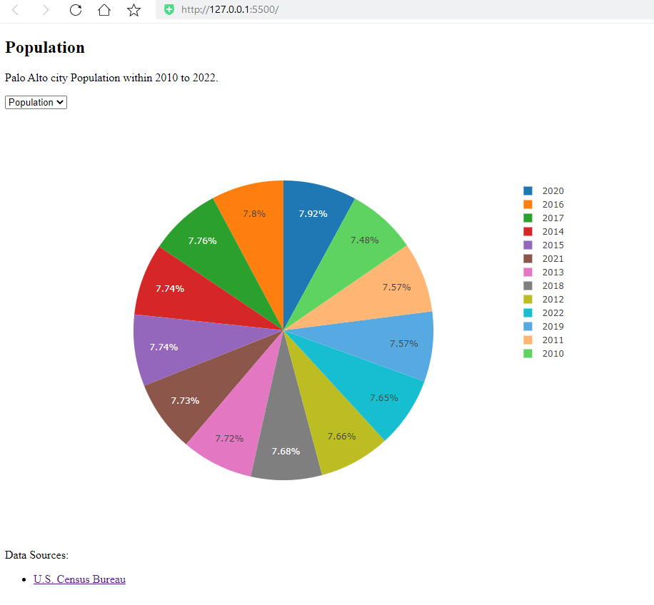
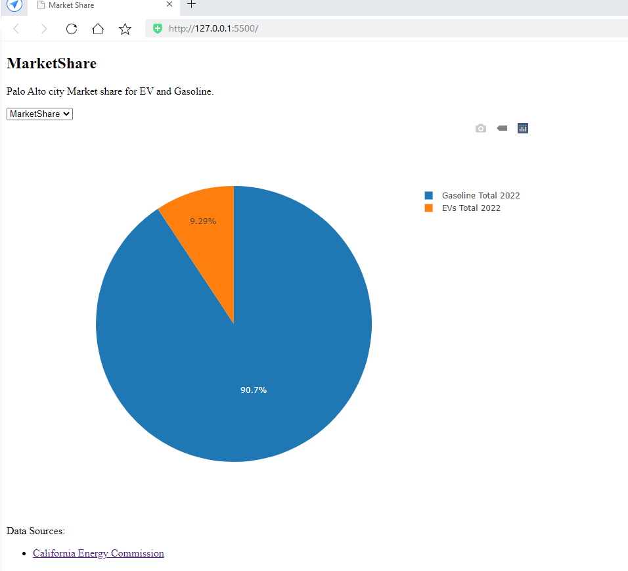
Population
EV Market share

Slide 6
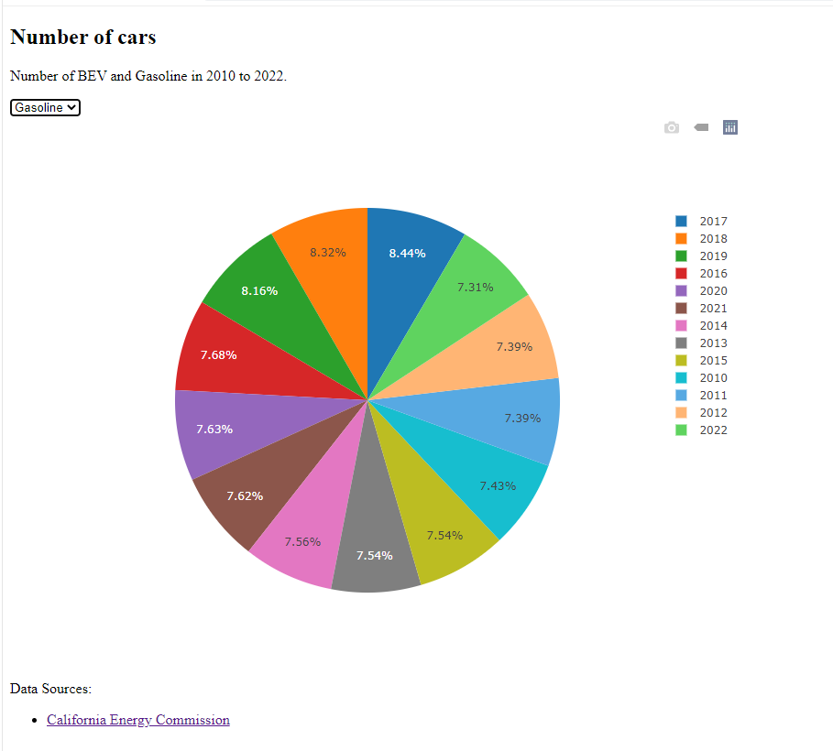
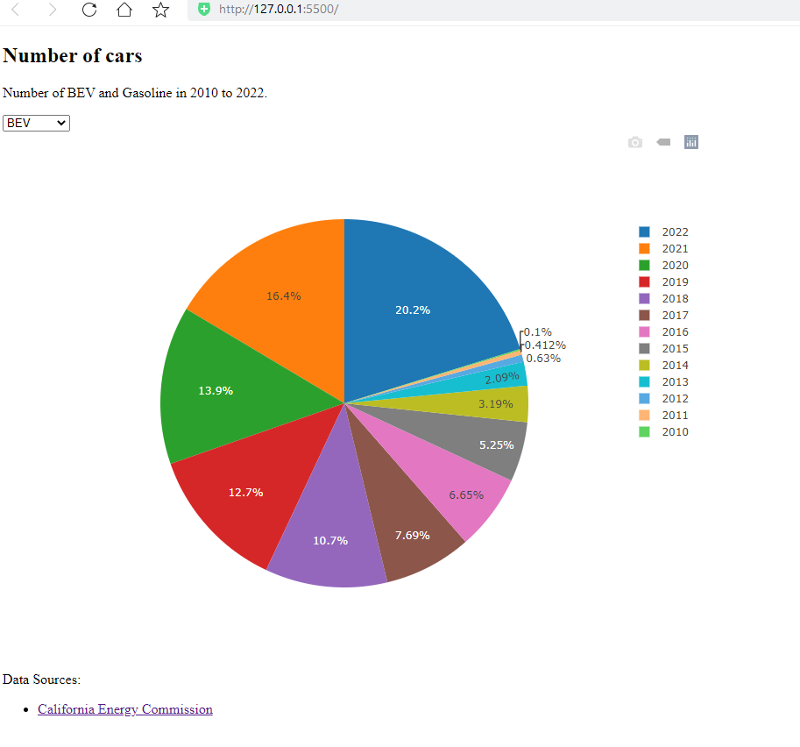
Number of Cars

Slide 7
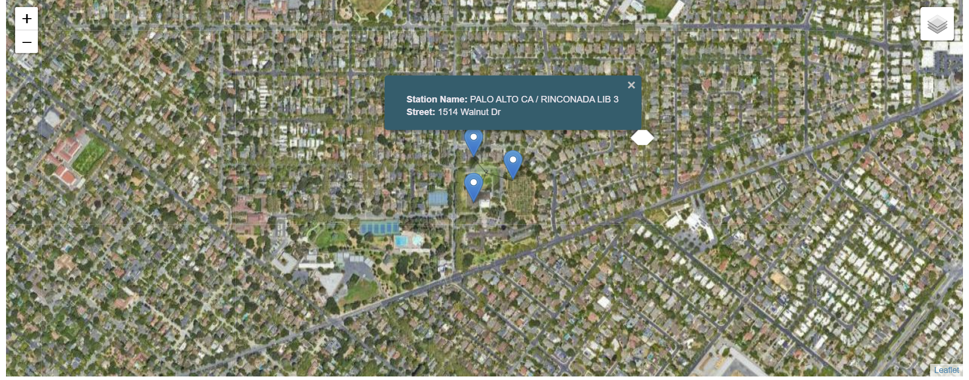
Leaflet Map Street Map, Goole Sat, Street Layers

Slide 8
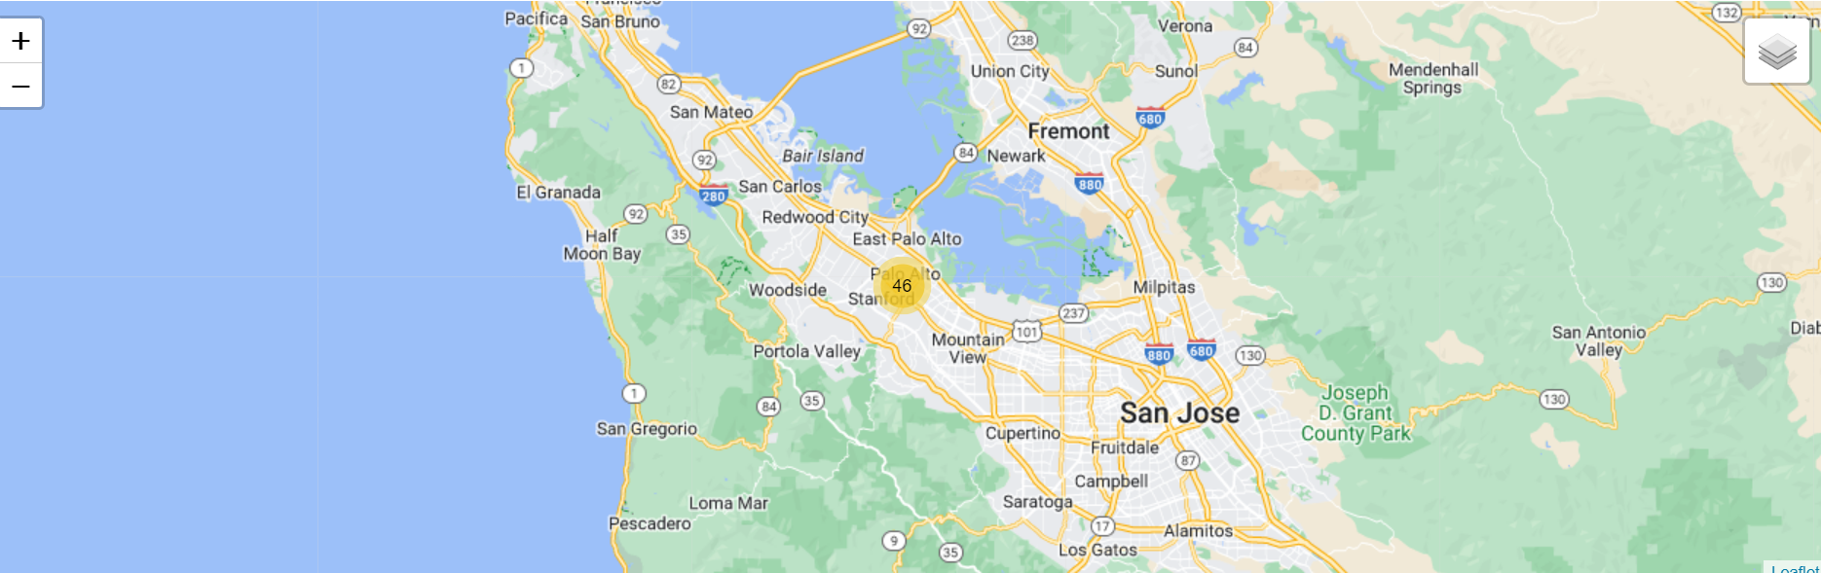
Leaflet Map – Marker Cluster Leaflet. marker cluster is a powerful tool for managing and visualizing large datasets of markers on a map, improving performance, and enhancing the user experience

Slide 9
Future Enhancements
Add more interactive features to the map
Could be applied on other cities
Create an App for EV stations

Slide 10

Thank You

